Slide 1
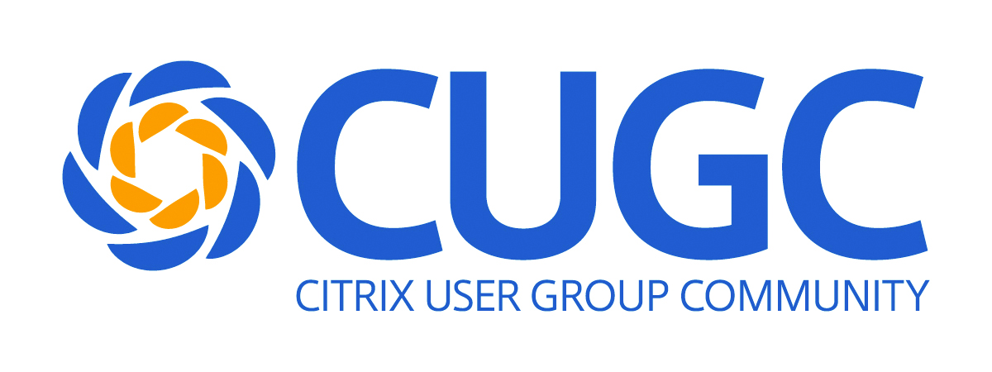
SYN304 – Comparison: Delivering Virtual Desktops
with XenDesktop 7.x or Horizon 7.x
Eduardo Molina, Jarian Gibson
Synergy 2017

Slide 2

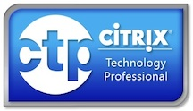
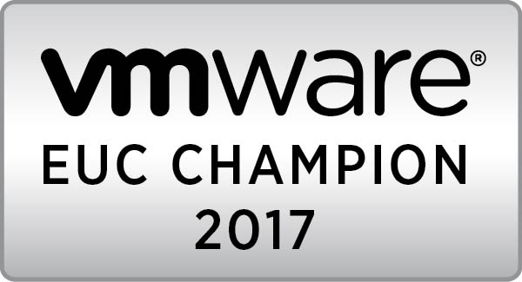


Please allow us to introduce ourselves…
Eduardo Molina
EUC Architect
RoundTower Technologies
@molikop
Jarian Gibson
Independent Consultant
Jarian Gibson Consulting
@jariangibson

Slide 3
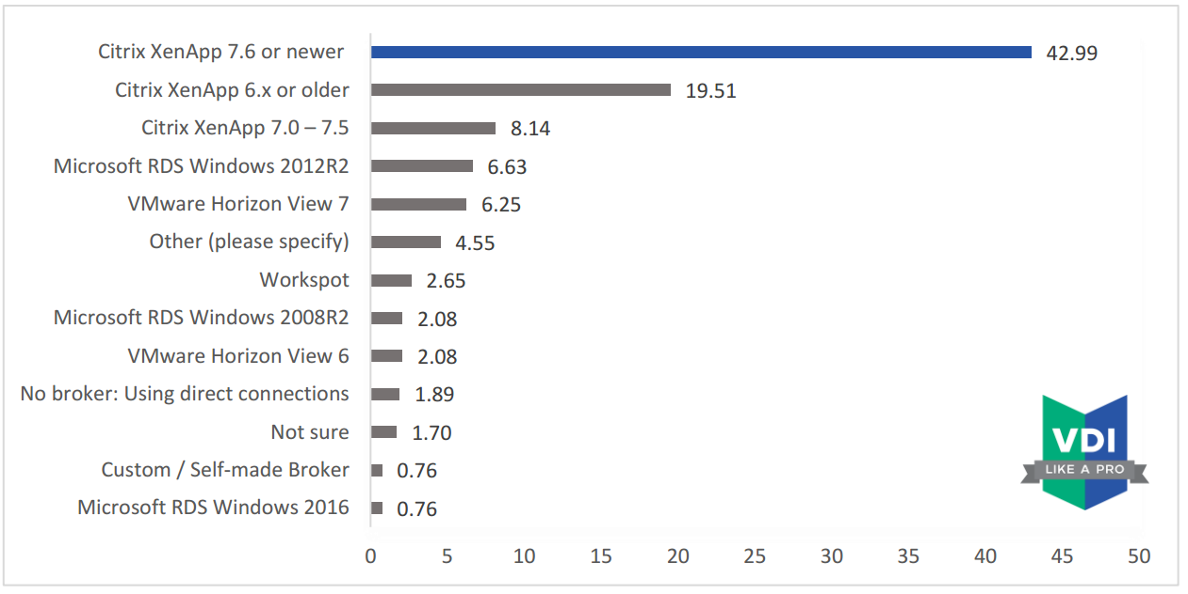
SBC Broker
Notes:
State of the VDI and SBC union 2017 http://www.vdilikeapro.com/

Slide 4
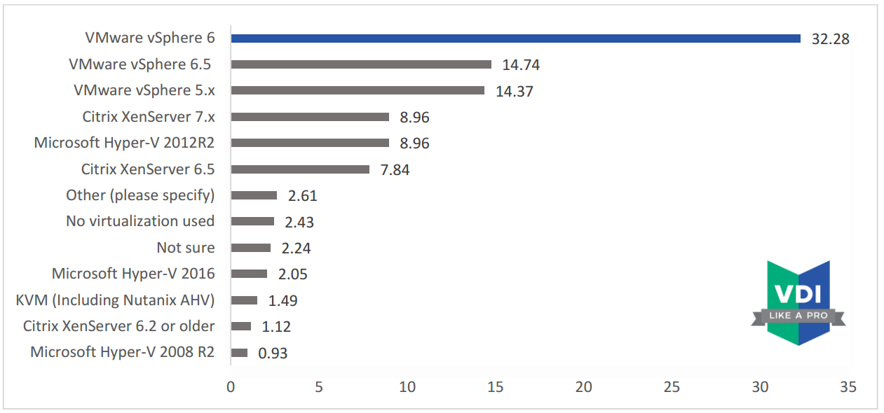
SBC Hypervisor
Notes:
State of the VDI and SBC union 2017 http://www.vdilikeapro.com/

Slide 5
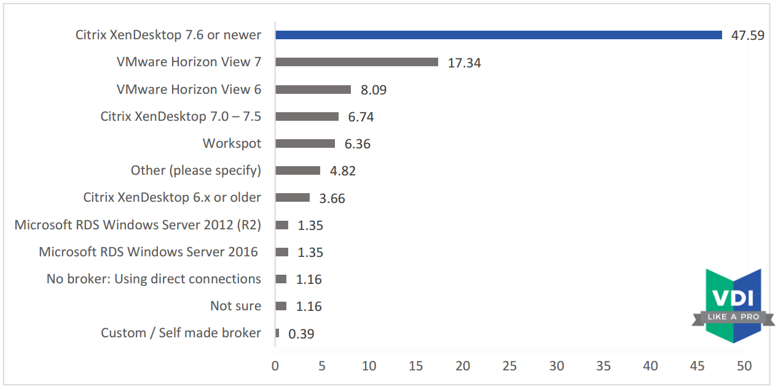
VDI Broker
Notes:
State of the VDI and SBC union 2017 http://www.vdilikeapro.com/

Slide 6
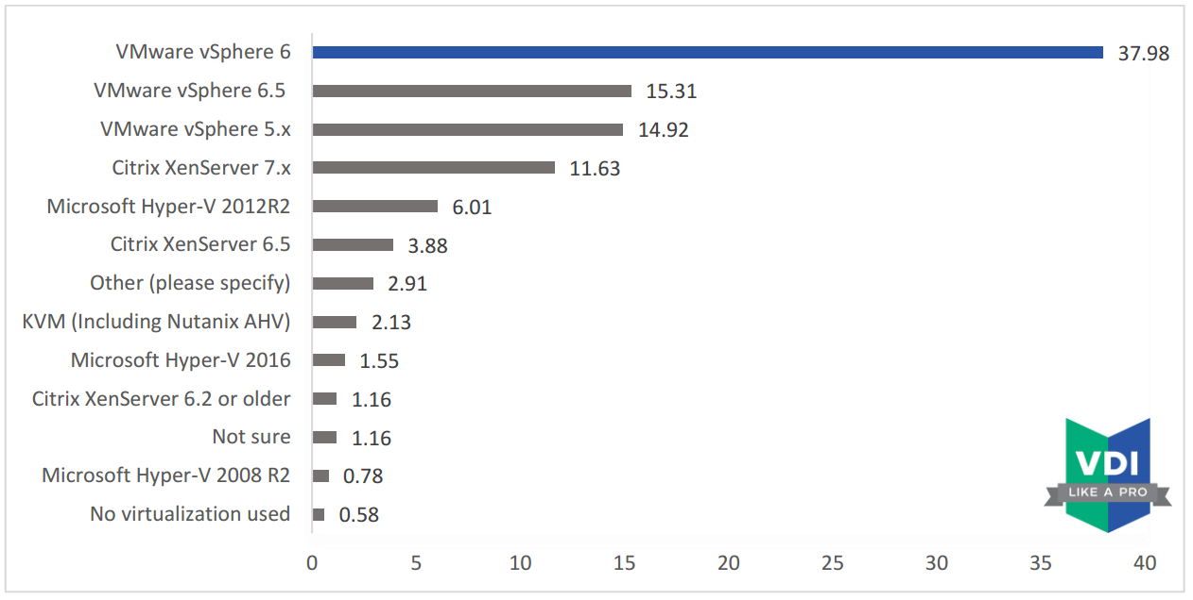
VDI Hypervisor
Notes:
State of the VDI and SBC union 2017 http://www.vdilikeapro.com/

Slide 7
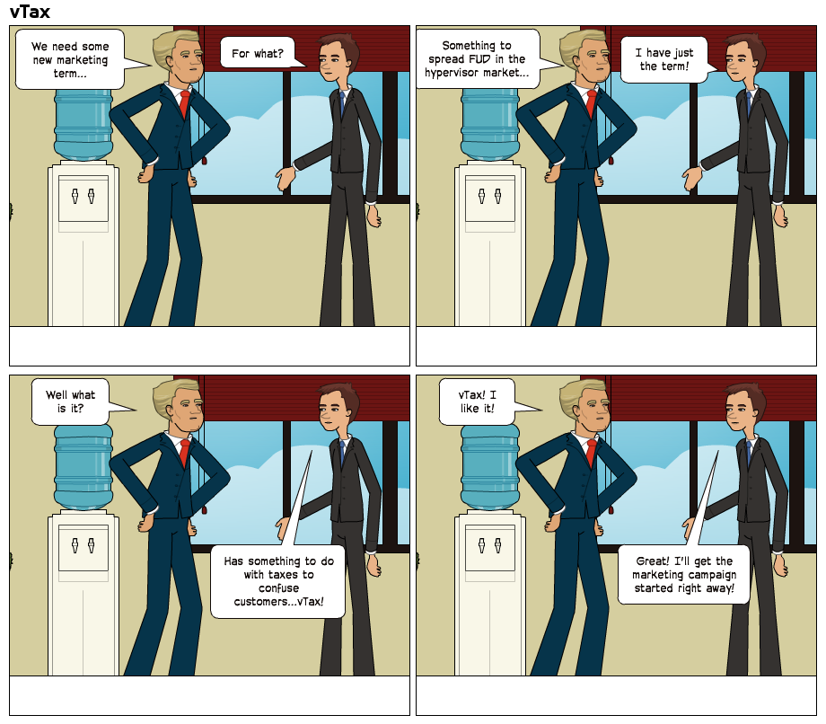
About that vTax…

Slide 8
Both XenDesktop & Horizon include the hypervisor!

Slide 9
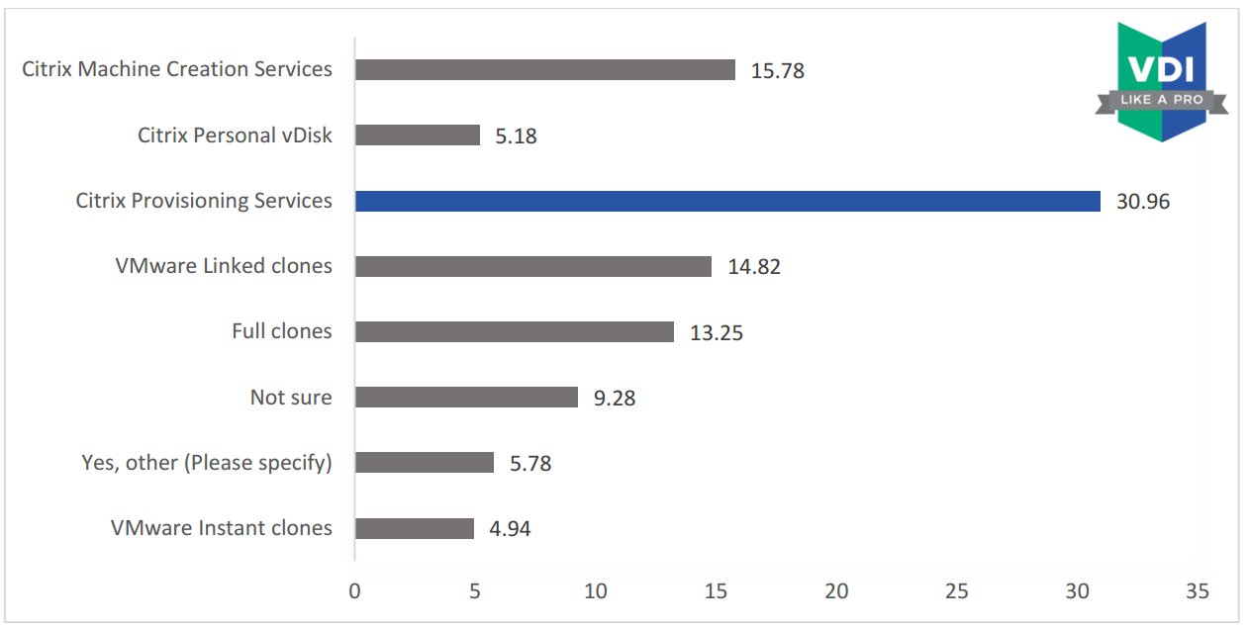
Provisioning Methods
Notes:
State of the VDI and SBC union 2017 http://www.vdilikeapro.com/

Slide 10
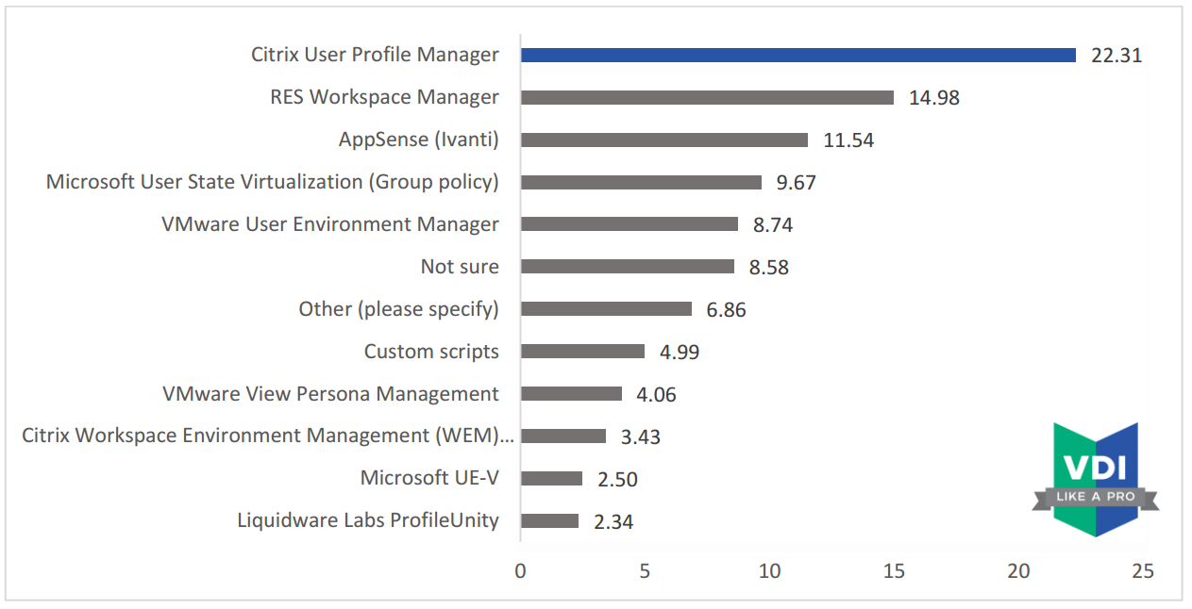
User Environment Management
Notes:
State of the VDI and SBC union 2017 http://www.vdilikeapro.com/

Slide 11
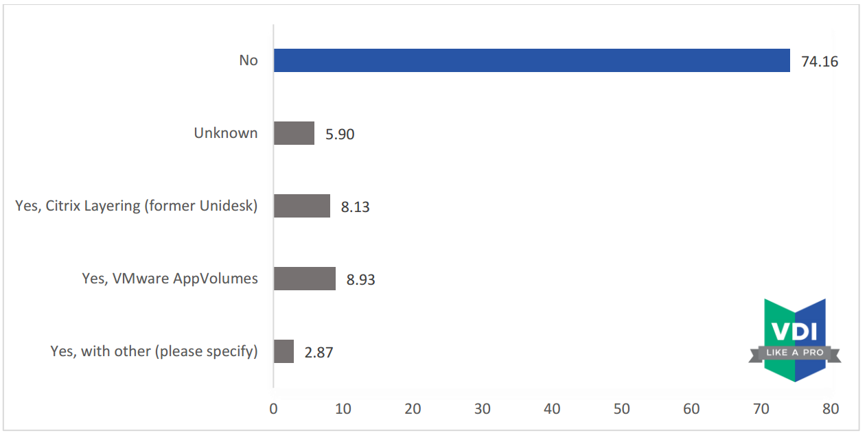
Application Layering
Notes:
State of the VDI and SBC union 2017 http://www.vdilikeapro.com/

Slide 12
Since our session last year…
Citrix acquisitions
Norksale – WEM
Unidesk – App Layering
XenDesktop enhancements
Local host cache
Director disk & GPU monitoring
Multi-type licensing
Adaptive Transport/EDT
AMD GPU
Intel Iris Pro
PVS Accelerator
Horizon enhancements
Instant Clones
Instant Clones for RDSH
Instant Clones vGPU
Instant Clones for XenDesktop
Blast Extreme Adaptive Transport/BEAT
Unified Access Gateway
Notes:
XenDesktop
LHC up to 10K VDAs per zone, 40K VDAs per site (multizone)
Multi-type licensing – mixed site of CCU & U/D
Horizon
Protocol enhancements for URL redirection, network recovery, H.264 codec, multimedia/flash enhancements, client drive redirection,

Slide 13
Desktop Virtualization Stack
User Layer
User Access and End-points – Citrix Receiver/VMware Horizon Client
Desktop Layer
User Settings, Golden Image(s), and Apps
Infrastructure (Management, File, AD, SQL, License)
Control and Access Layer
Brokers & Image Management/Provisioning
Access Controllers
Hypervisor
Citrix XenServer/Microsoft Hyper-V/Nutanix AHV/VMware vSphere
Compute and Storage (HW)
Compute/Networking/Storage

Slide 14
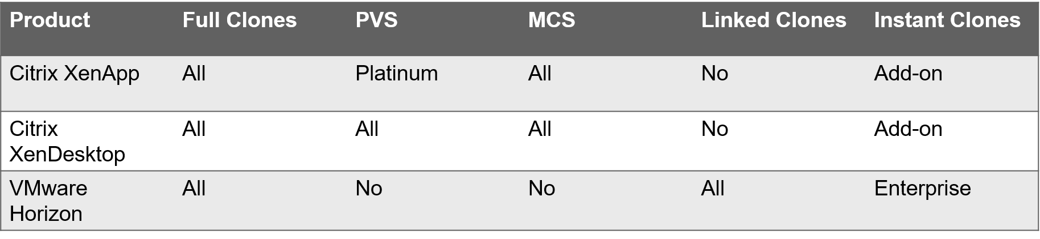
Know your provisioning/image management options
Know Your Provisioning/Image Management Options!

Slide 15
Image Management and Provisioning Methods
Feature | Full Clones | PVS | MCS | Linked Clones | Instant Clones
Hypervisor | AHV,HV,VS, XS | AHV,HV,VS, XS | AHV,HV,VS, XS | vSphere | vSphere
Delivery | Storage based | Network based | Storage based | Storage based | Storage based
Platform | Virtual | Virtual/ Physical | Virtual | Virtual | Virtual
Storage | Datastore/ Snapshot | Disk/VHDX | Datastore/ Snapshot | Datastore/ Snapshot | Datastore/ Snapshot
Infrastructure | Integrated in Horizon/XD | Separate from XD | Integrated in XD | Separate from Horizon | Integrated Horizon/ Separated XD

Slide 16
Image Management and Provisioning Methods OS Support
OS | Full Clones | PVS | MCS | Linked Clones | Instant Clones
Windows | Yes | Yes | Yes | Yes | Yes
Linux | Yes | Yes | No | No | No

Slide 17
Hypervisor Integration Methods
Hypervisor | Full Clones | PVS | MCS | Linked Clones | Instant Clones
Citrix XenServer | Pool Master | Pool Master | Pool Master | N/A | N/A
Microsoft Hyper-V | VMM/ Scripted | VMM/ Scripted | VMM | N/A | N/A
Nutanix Acropolis Hypervisor | Plugin/ Scripted | Scripted | Plugin/ Scripted | N/A | N/A
VMware vSphere | vCenter | vCenter | vCenter | Composer/ vCenter | vCenter/ Plugin/ AppVolumes

Slide 18
PVS Wizards vs Scripted
M/M = Multiple Hosts/Multiple Storage
M/S = Multiple Hosts/Single Storage

Slide 19
PVS Wizards vs Scripted
XenDesktop Setup Wizard
Disks in Template Discarded
Write Cache set to Server
Each VM Booted
BDM & WC Disks Created
Shutdown
Write Cache set to vDisk Settings
Streamed VM Setup Wizard
Single Storage Location only – Template Storage Location
Scripted
Fast
Multiple Storage Locations
Template with WC Disk
Hyper-V w/o SCVMM!

Slide 20
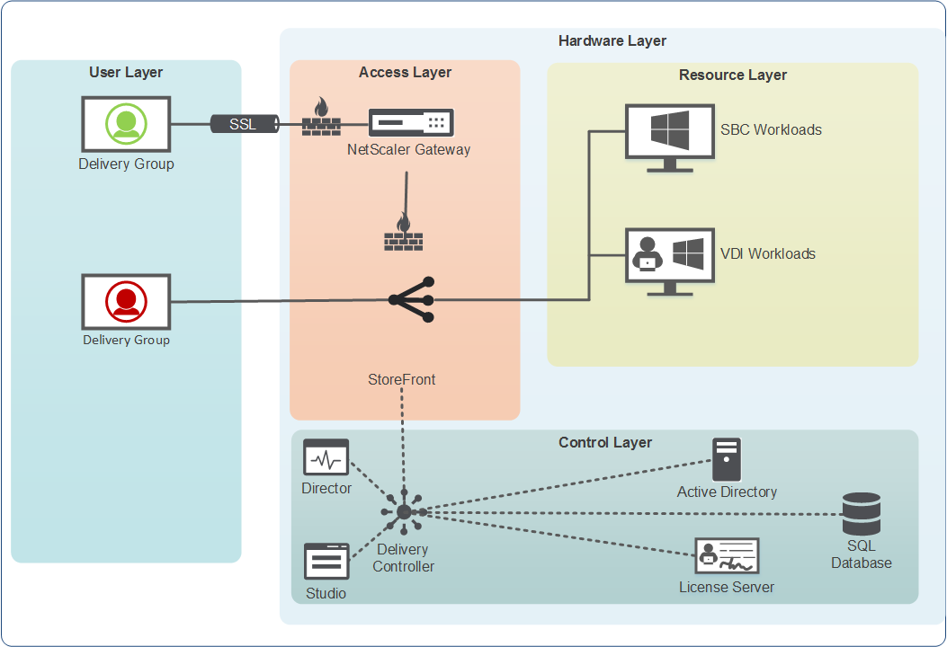
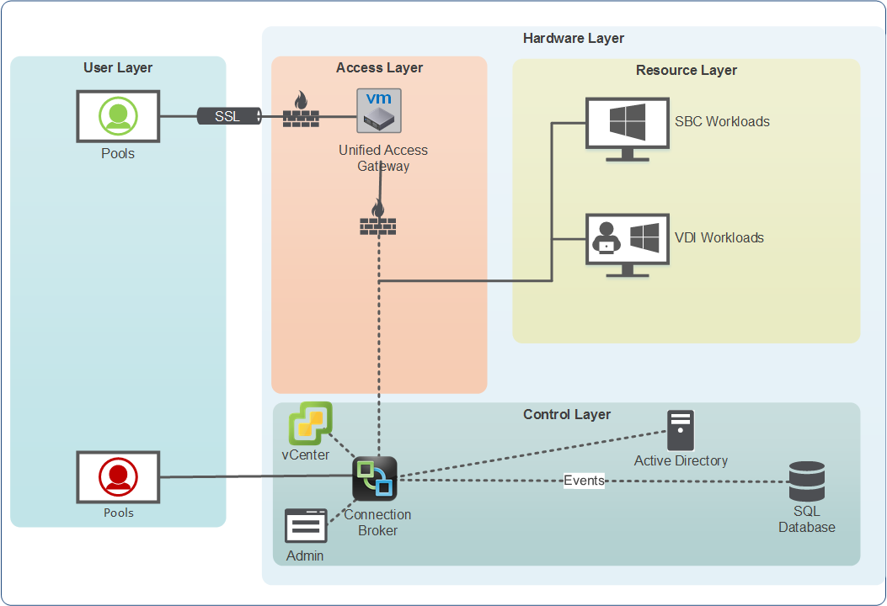
Simplicity…

Slide 21
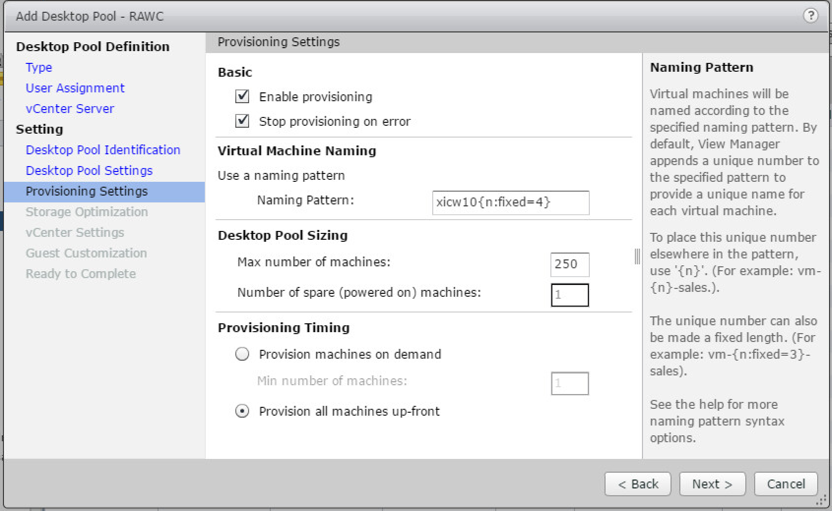
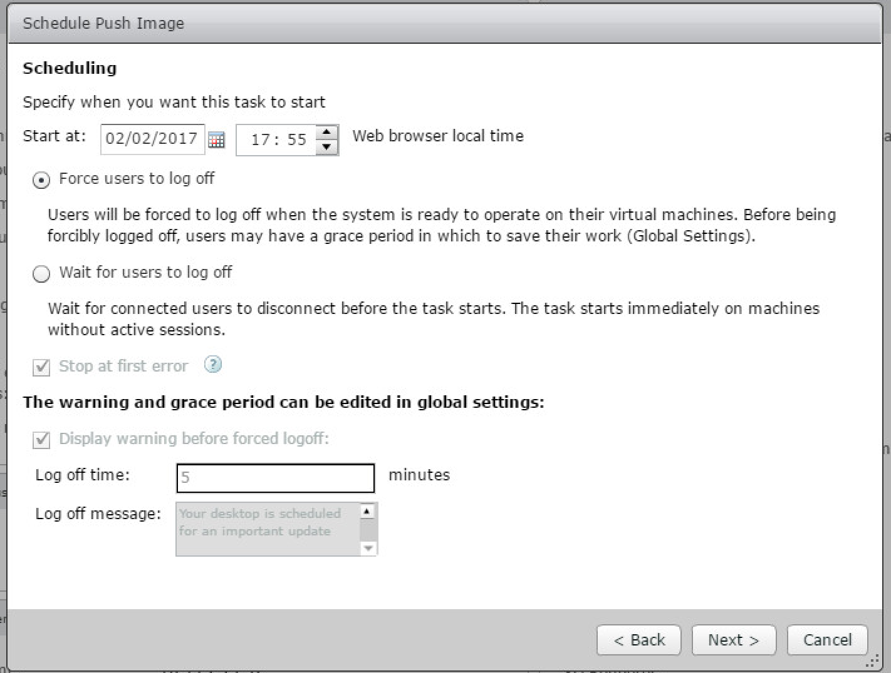
Convenience…

Slide 22
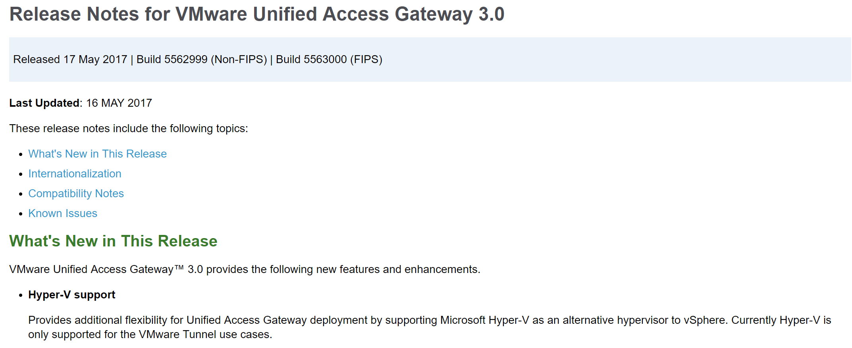
Remote Access…
XenDesktop
Included but not included
Secure Gateway
NetScaler Gateway
HDX Proxy!?
Horizon
Included
Security Server
Unified Access Gateway
Notes:
HDX Proxy?

Slide 23
The Cloud...

Slide 24
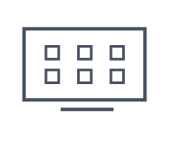






Citrix Cloud Management
Citrix Cloud - Control Center
XenApp & XenDesktop Service
XenMobile
Service
ShareFile Service
Lifecycle Management Service
Citrix architects & operates
Apps and Desktops
Mobile App & Device Mgmt
File Sync & Sharing
Design, Deploy, Manage
Citrix Cloud - Service Platform
Cloud Connector
Cloud Connector
Cloud Connector
Cloud Connector
Customer / Partner architects & operates
Data Center
Worker Pods
Public Cloud
SP Cloud

Slide 25
Citrix Cloud Platform¹
Customer Resource Location
Port 443
Identity & Access Management
Citrix Cloud Management UI (Library, Connectors, Resource Locations)
Customer Resources
Azure Service Bus
Logging & Health Services
Firewall
Firewall
Support Ticketing
DMZ
Azure Active Directory
Licensing
Citrix Cloud Connectors
Customer Feedback
Port 443
Port 443
Other (e.g. What’s New, Trial Requests)
Active Directory
Port 443
XenApp/XenDesktop Service¹
Various Citrix Internal Systems (e.g. Support, Customer Feedback, Trial Requests etc)
Citrix Cloud Resource Provider
StoreFront*
SQL Database (PaaS)
Delivery Controllers
NetScaler Gateway*
Hypervisor or IaaS
Gateway Service²
Director
Server VDAs
Desktop VDAs
Studio
Cloud StoreFront
*Customer managed StoreFront and NetScaler Gateway are optional depending on deployment

Slide 26
Citrix Cloud Demo

Slide 27
VMware Horizon Cloud with On-Premises Infrastructure

Slide 28
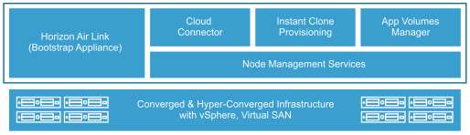
VMware Horizon Cloud Node
Horizon Air Link (HAL) - ssl 443 socket outbound (1 only for now)
Unified Access Gateway - v2.9 (multiple)
Horizon Cloud Node Management appliance (Smart Node) is single management appliance
used to be 6 appliances to 1 (1 only for now)

Slide 29
VMware Horizon Cloud with On-Premises
Must run on vSAN, VxRail or vSAN ReadyNode
Connectors for VxRail on market place
Only Desktops (for now)
Based on JMP – just-in time platform
Instant Clones
App Volumes
User Environment Management

Slide 30
VMware Horizon Cloud Demo

Slide 31
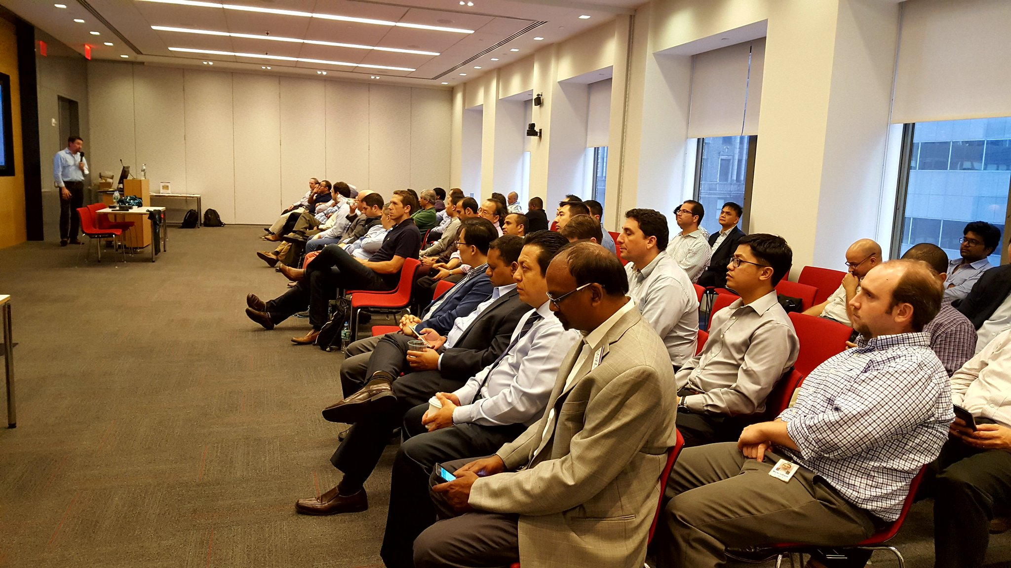
Find us at the Community Hub
in Synergy Park!
For the users, by the users
16,000+ members globally
60+ local user groups and special interest groups (SIGs)
Knowledge sharing, expert discussion
Networking at local meetings, conferences and technology events
Technical webinars, forums and blogs
Opportunities to share, learn, mentor and lead
“It was an opportunity to bring together like-minded people, network,
share stories, and help each other.” – CUGC Member

Slide 32
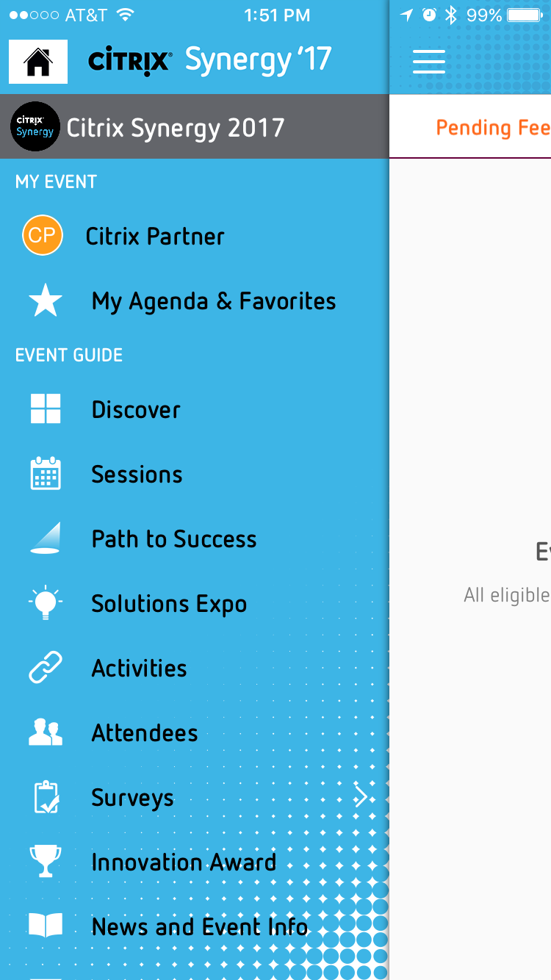
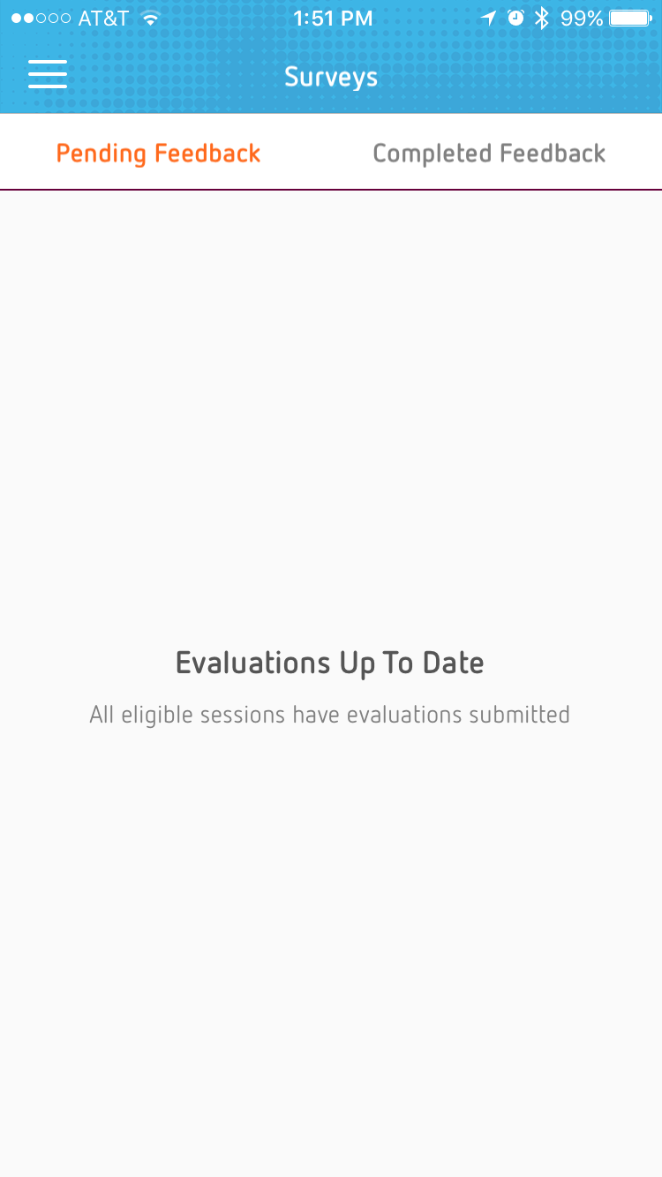
Rate this session in the mobile app
Surveys are based on entrance scanning
Once you scan in to a session, that session will pop up on the mobile app
Complete the survey on the mobile app
The mobile app will show you pending feedback and completed feedback
Pending – surveys to take
Completed – completed surveys

Slide 33

Before you leave…
Conference Surveys are available via email and in the Synergy Mobile app starting Thursday, May 25 at 9:00 a.m. ET
Those who provide feedback by Friday, May 26 at 6:00 p.m. ET will receive a $20 Amazon e-gift card
Watch sessions on demand beginning Friday, June 2 at www.citrix.com/SynergyTV
Download presentations starting Friday, June 9 from your My Synergy Account
This Photo by Unknown Author is licensed under CC BY-NC-ND
This Photo by Unknown Author is licensed under CC BY-NC-ND

